Slide 1
Magnitude of crustal extension in the southern Great Basin
Brian Wernicke, Jon E. Spencer, B. Clark Burchfiel, Peter L. Guth
1982
Presentation by James McNeil

Slide 2
Introduction
Amount of total Cenozoic extension in B&R has been extremely challenging to constrain
10-100% (70-400 km) in northern B&R
Conservative estimate 10-30% (Thompson, 1960)
Assumes normal faults where extension & rotation are proportional
20-30% for entire B&R (modern B&R) (Stewart, 1980)
Notes:
60 degree faults 15-20 degree tilts

Slide 3
Assumptions for Liberal Estimates
1. Relative crustal thickness between B&R, S.N., and Co. Plateau 20-30% (Hamilton, 1978)
Current 25-35 km B&R vs. 45-50 km Co. Plateau
2. Palinspastic reconstruction of Mesozoic Cordillera 50-100% (Hamilton and Meyers, 1966; Hamilton, 1969)
Sierran batholith → ←Idaho batholith
3. Cenozoic clockwise rotation of western Cascades 74% (340 km) in northern B&R and 140% (210 km) at latitude of Las Vegas (Magill and others, 1981)
Could be as low as 36% (210 km) and 33% (80 km) respectively based on uncertainty

Slide 4
Strike-Slip Faulting
Restoring offset linear features across strike-slip faults between areas of differential extension (Hamilton and Myers, 1966; Wright and Troxel, 1970; Davis and Burchfiel, 1973; Guth, 1981)
Provides a minimum for sub-regional extension
Distribution of strike slip faults in southern Great Basin @ latitude of Las Vegas provide accurate estimation for regional extension

Slide 5
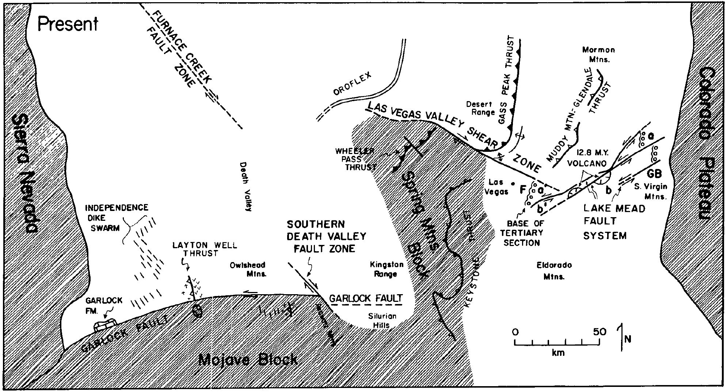
Stable Blocks
Sierra Nevada, Mojave + Spring Mtns. Block, Colorado Plateau

Slide 6
Garlock Fault
64 km left-lateral offset of Independence dike swarm (Smith, 1962)
64 km

Slide 7
Garlock Fault
48-64 km left-lateral offset of Paleozoic Garlock Formation (Smith and Ketner, 1970)
48-64 km

Slide 8
Garlock Fault
56-64 km left-lateral offset of Layton Well thrust (Smith, 1962)
56-64 km

Slide 9
Garlock Fault
Minimum estimate of 60 km net crustal extension north of Garlock Fault (assuming no crustal shortening to the south)
Min.
60 km

Slide 10
Las Vegas Valley Shear Zone
Oroflex - “Large scale bending” (Albers, 1967)

Slide 11
Las Vegas Valley Shear Zone
Initial estimate of 23 km right lateral offset of Glass Peak thrust and Wheeler Pass thrust (Longwell, 1974)
23 km

Slide 12
Las Vegas Valley Shear Zone
23 km (faulting) plus 21-25 km (bending) [Total = 44-69 km] right lateral offset of Glass Peak thrust and Wheeler Pass thrust (Longwell, 1974; Stewart and others, 1968)
44-69 km

Slide 13
Lake Mead Fault System
20 km left lateral offset of 12.7 m.y. Hamblin Cleopatra stratovolcano and speculated 65 km cumulative displacement (Anderson, 1973)
20 km

Slide 14
Lake Mead Fault System
65 km left lateral offset of Frenchman Mountain and South Virgin Mountains (Bohannon, 1979)
65 km

Slide 15
Lake Mead Fault System
40 km left lateral offset of River Mountains with volcano-plutonic rocks in the northern Black Mountains (b’ – b) (Smith, 1981)
40 km

Slide 16
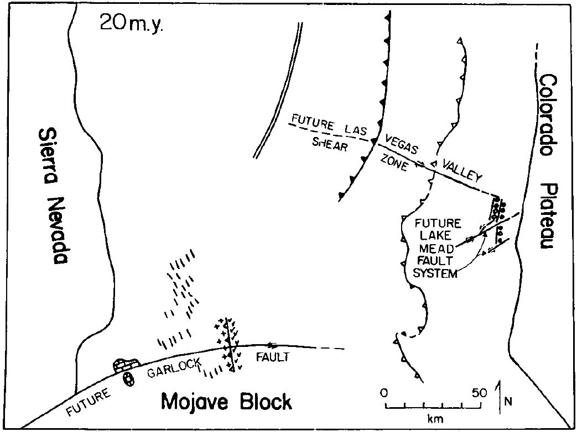
Discussion
80-100% total extension is possible
Uncertainty tends to increases the estimate
Northern B&R has similar crustal thickness and likely 60-80% (300-500 km) net extension
140 km

Slide 17
Discussion
Extension of lithosphere by 2x without forming OC crust may be common
Stable terrains possibly underlain by low-angle normal faults
Relating timing and kinematics of individual extended terrains relative to strike-slip faulting is still needed
140 km

Slide 18
Takeaway point: Minimum of 65% extension (140 km) occurring between the southern Sierra Nevada and the Colorado Plateau.

